Slide 1
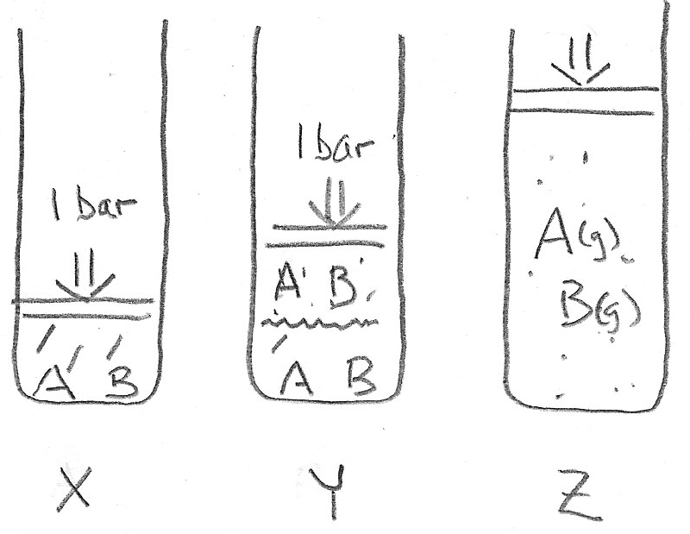
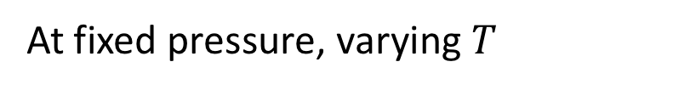
Vapor enrichment of volatile components
If A is more volatile than B, then the gas will be enriched in A, compared to the liquid
At fixed pressure, varying $T$
That means the liquid will be enriched in B, compared to the gas
Same composition whether it’s liquid mixture or gas mixture

Slide 2
Constructing a temperature-composition diagram
At fixed pressure, varying $T$
T
Mole fraction of A ->
<- Mole fraction of B
A is more volatile than B

Slide 3
Constructing a temperature-composition diagram
T
Vapor
Liquid
Mole fraction of A ->
<- Mole fraction of B

Slide 4
Constructing a temperature-composition diagram
T
#P=1
#P=2
Vapor
#P=1
Liquid
Mole fraction of A ->
<- Mole fraction of B

Slide 5
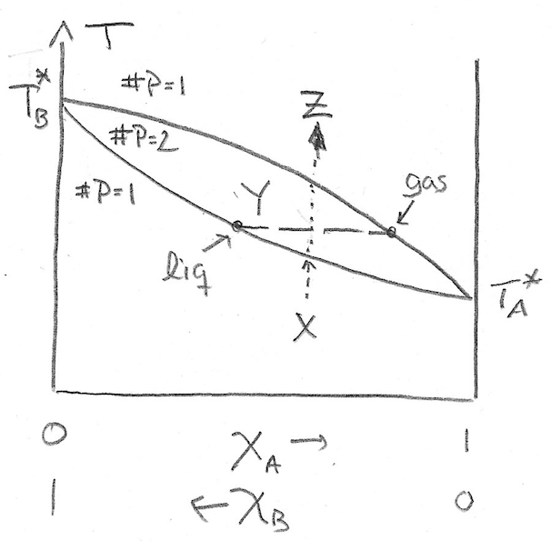
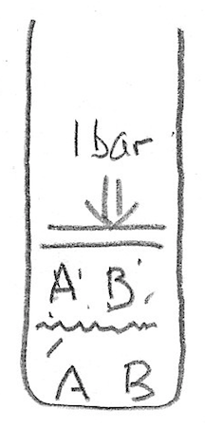
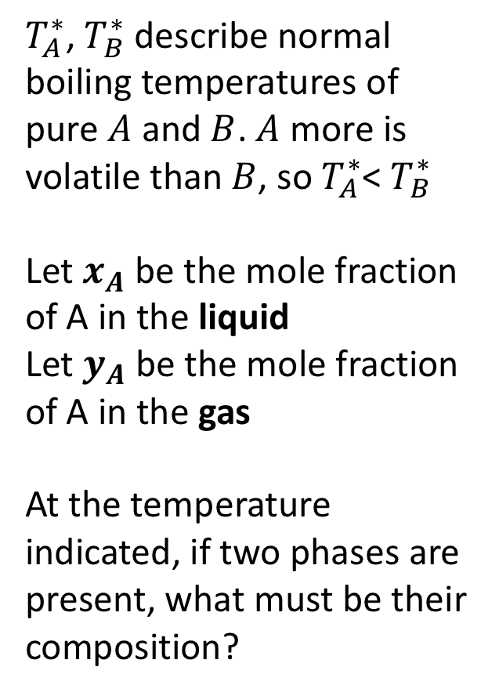


Temperature-composition diagrams
$T_{A}^{∗}$, $T_{B}^{∗}$ describe normal boiling temperatures of pure $A$ and $B$. $A$ more is volatile than $B$, so $T_{A}^{∗}$< $T_{B}^{∗}$
Let $x_{A}$ be the mole fraction of A in the liquid
Let $y_{A}$ be the mole fraction of A in the gas
At the temperature indicated, if two phases are present, what must be their composition?
$y_{A}$
$x_{A}$

Slide 6
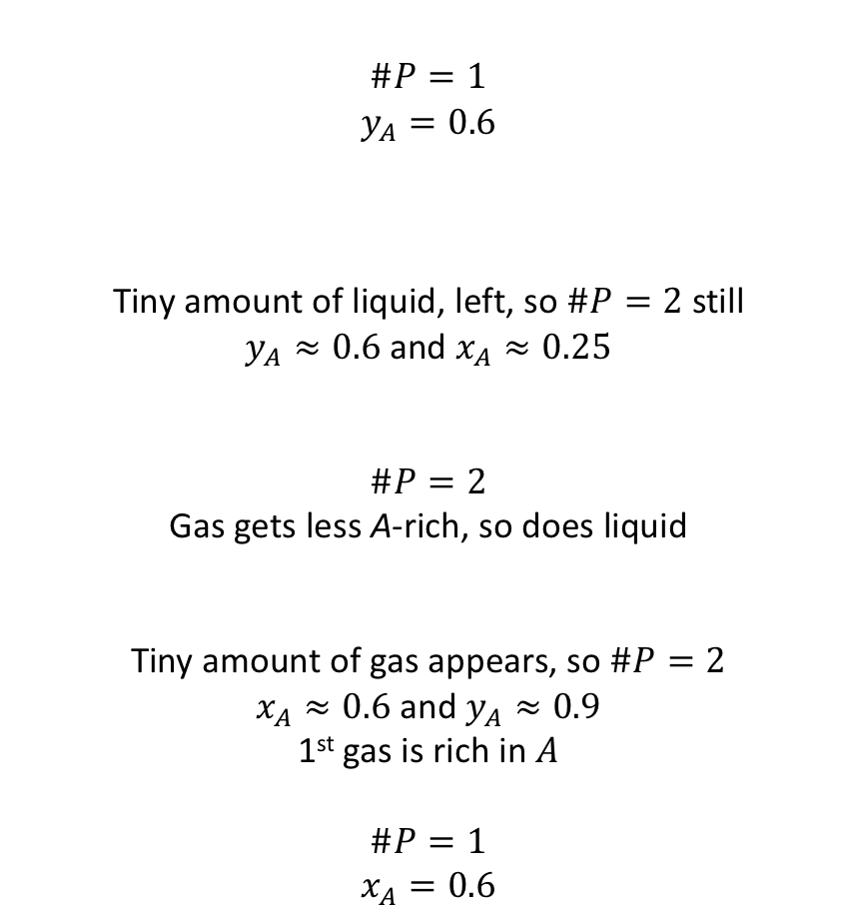
Increasing the temperature from pure liquid … what happens?
$$\#P=1$$
$y_{A}=0.6$
Tiny amount of liquid, left, so $\#P=2$ still
$y_{A}≈0.6$ and $x_{A}≈0.25$
$$\#P=2$$
Gas gets less A-rich, so does liquid
Tiny amount of gas appears, so $\#P=2$
$x_{A}≈0.6$ and $y_{A}≈0.9$
1st gas is rich in $A$
$\#P=1$
$$x_{A}=0.6$$

Slide 7
What if you could take the A-enriched gas, and turn it into a liquid?
Now we have liquid that’s more rich in A than we started with. Called simple, or 1-plate distillation

Slide 8
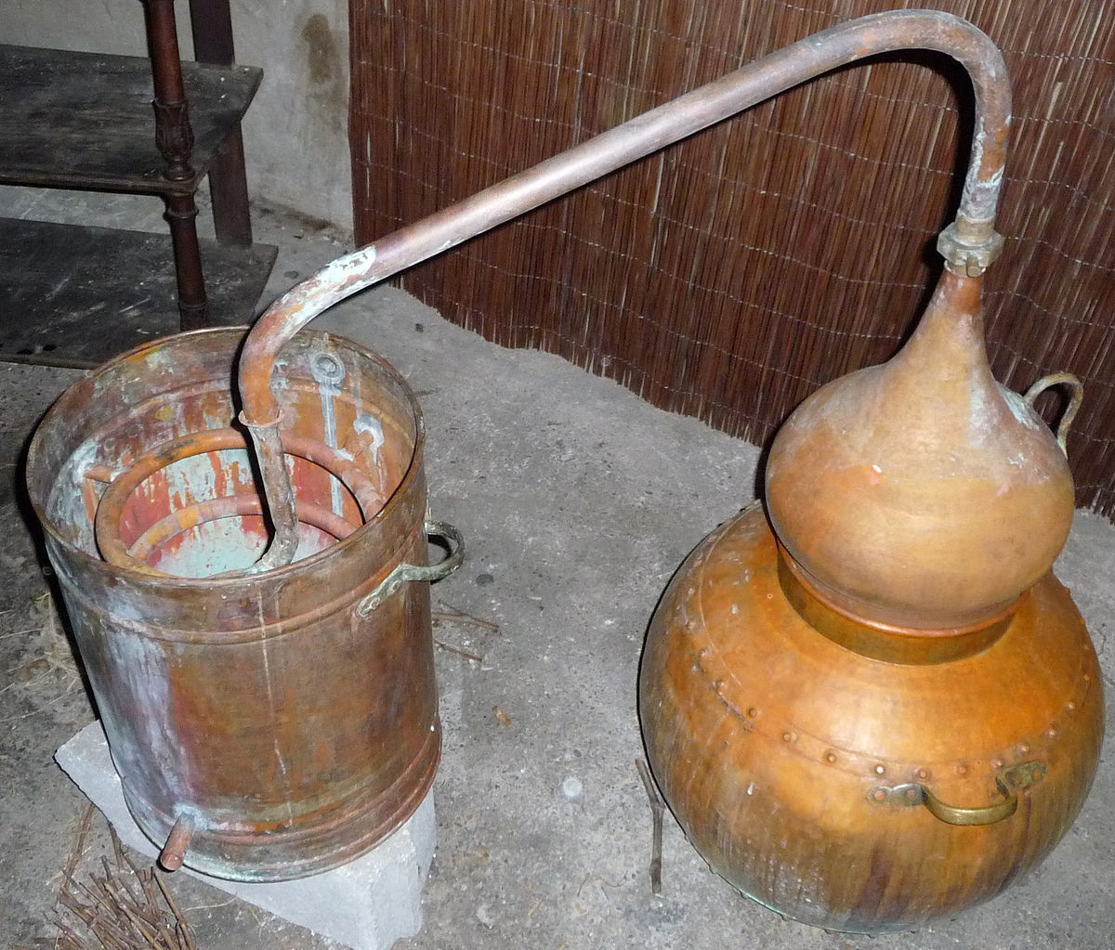
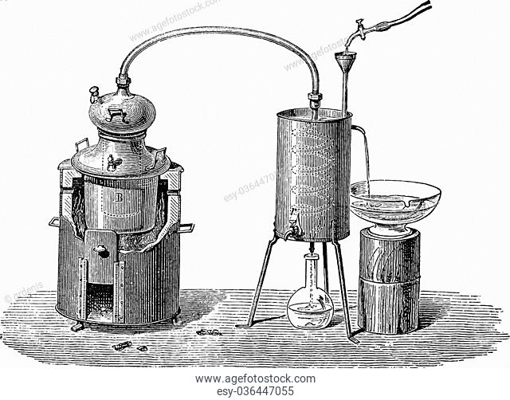
1-plate distillation apparatuses

Slide 9
What if you could take the A-enriched gas, and let it equilibrate with its vapor?
If you collect this liquid, it would be a 2-plate distillation.

Slide 10
Every time you do this, you get more enrichment of component A

Slide 11
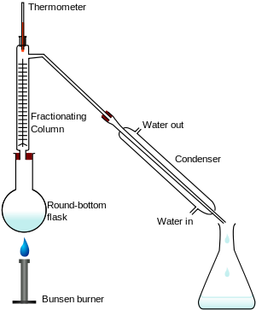
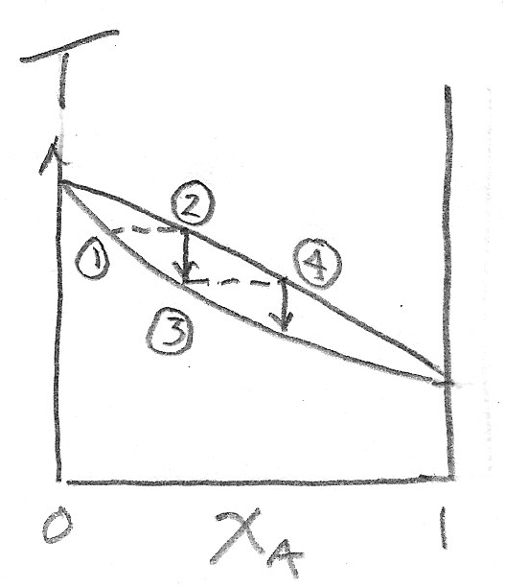
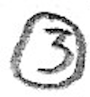


Fractional distillation
hot
cold
cold
hot

Slide 12
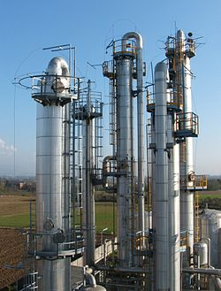
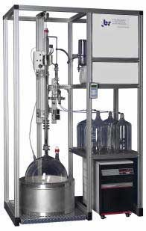
Commercial-scale distillation

Slide 13
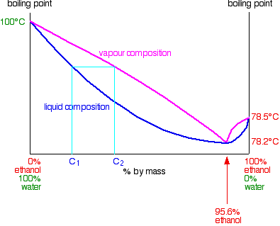
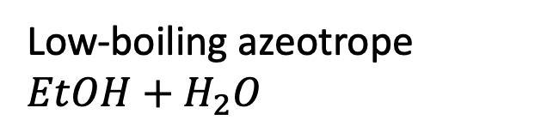
Azeotropes
Low-boiling azeotrope $EtOH+H_{2}O$
B is water
A is ethanol

Slide 14
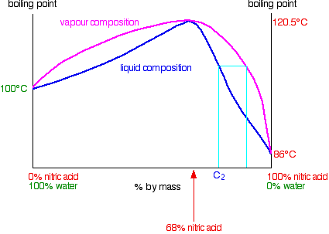
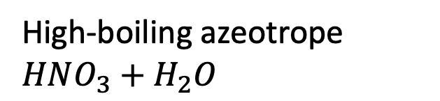
Azeotropes
High-boiling azeotrope $HNO_{3}+H_{2}O$

Slide 15
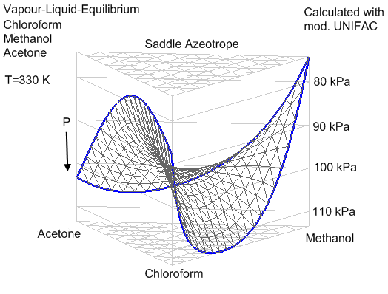
Saddle azeotrope

